Slide 1
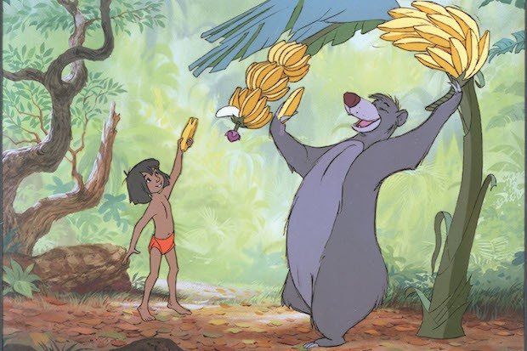
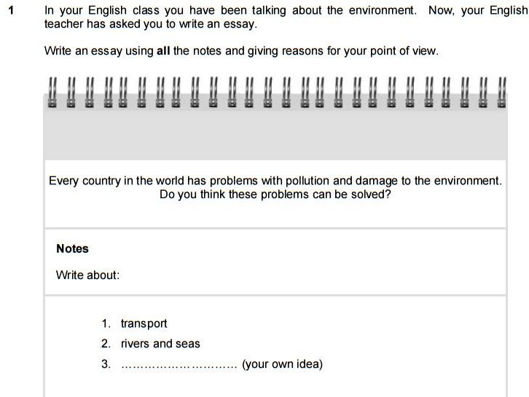

THE BARE NECESSITIES
B2 FCE Writing and Speaking language and grammar masterclass
MAKE SURE YOU ARE FAMILIAR WITH WHAT IS EXPECTED FOR EACH TYPE OF TASK.
TARGET READER - What is the register?
FORMAT - What is the traditional way to answer that type of writing?
TITLE - Do you need one?
PUNCTUATION - Appropriate to the expected format
INCLUDE A VARIETY OF LINKING & CONNECTING PHRASES + GRAMMATICAL FORMS
BE CONSCIOUS OF WHAT YOU’RE WRITING - CHECK spelling/repetition/upgrades (adding interest)
ESSAY
I would stick to the 5 paragraph format:
INTRODUCTION TOPIC 1
TOPIC 2
TOPIC 3
CONCLUSION
* Always spend 2 minutes brainstorming 3rd IDEAS and then choose the most suitable. It’s difficult, so that’s why I provide a list.
It should be relevant & different to first two
INTRODUCTION - Include the question (paraphrased) It helps you stay focused on answering the question. - Make a statement and pose a question:
“It is often claimed that / A recent survey has shown that every country in the world faces challenges with environmental pollution and damage. But are these problems really solvable / is it really possible to solve these problems?”
MAIN BODY PARAGRAPHS - Make sure they are well organised and linked using words/phrases. - Make a statement and follow up with a reason and / or examples: “To begin with, transport is an essential part of modern life to move people and the things we need, such as clothes, food and materials. However, the exhaust fumes pollute the atmosphere, which leads to climate change. In order to reduce the impact we have, we could buy products that are locally produced and use public transport or bikes to get from one place to another. Furthermore the government could make it easier and less expensive to use electric vehicles, so they could replace polluting engines.”
Writing
1
2
1
2
could
~ should
could
~ ought to
CONCLUSION - Needs to reflect the sentiment of the main body and answer Q. Don’t add new information. - Make sure you answer the question: “It is clear to see that there are many problems to overcome, although there are many ways to solve them, and therefore, I believe that we can do that and meanwhile lessen the damage we cause to the environment”
You HAVE TO write the essay, so you need to learn to do it well. Include a variety of:
MODAL VERBS / PASSIVE / REPORTED SPEECH / CONDITIONAL FORMS / RELATIVE CLAUSES / COMPARATIVE FORMS / INVERSION / PHRASAL VERBS / VERB + PREPOSITION / VERB + -ING / +INF
Check your use of WILL and CAN - is that what you mean, or could you use a better verb? Same with adjectives
A minimum of 12 linking and connecting words/phrases.

Slide 2


ARTICLE
Make sure you include a title (best to do it at the end, but don’t forget!)
Think about register - who is the target reader? If it’s serious, stay serious.
If it’s more light-hearted or humorous, keep it that way throughout.
Swimming is good for you.
Should you try swimming?
Title
INTRODUCTION BODY PARA 1
BODY PARA 2
CONCLUSION
Relevant - 2 to 5 words - eye catching / humourous
Taking the plunge!
Ask a (rhetorical) question or make a bold challenging statement / quotation
“ Have you ever…”
Describe the first issue / point of interest & why is it important to you/the reader
* personalise with stories or anecdotes
Describe the second issue / point of interest & why is it important to you/the reader
State a summary opinion, give the reader something to think about / end with a relevant quotation
* A quotation doesn’t need to be true, but it does need to be believable and relevant
The main thing with an article is you have to catch the reader’s attention and keep them wanting to read on.
So you need to use interesting advanced vocabulary, challenge them to think, amuse them.
LETTER
Double check who you’re writing to - semi-informal or informal register.
As it impacts the conventions of the task.
GREETING INTRODUCTION BODY PARA 1
BODY PARA 2
BODY PARA 3
CONCLUSION
SIGN OFF
SIGN (your name)
Hi _____ ! (informal) Dear _____ , (semi-informal)
Thank them for their letter, and make a general comment about why you’re writing.
Answer the first query/topic. It’s usually prescriptive, but if not allow for 3 paragraphs.
Answer the second query/topic.
Answer the third query/topic.
I hope that … my thoughts are useful for you and you publish my letter / you find my advice helpful.
Best wishes,
The tricky thing with the letter, in particular the informal kind, is that you still need to get plenty of linking and connecting phrases in as well as complex grammar. It’s difficult to do that if you’re writing to a friend.
REVIEW
This is probably the most formulaic of all the writing types. However you need to tailor it to the subject, and it requires some technical vocabulary.
The key to a good review is to be informative, but not spoil it for the reader though.
Title INTRODUCTION BODY PARA 1
BODY PARA 2 CONCLUSION
Like an article, this should catch the reader’s attention. * Don’t make it positive if your review is negative!
Factual information. What, who, where, when, headline information. When you experienced it.
General description of what it’s about / to expect (no spoilers!)
Specific things that were good and/or could be improved. Use descriptive words and comparative forms!
Your overall view and recommendation.
STORY
This is probably the most difficult to do well, especially if you’re not used to creative writing.
Title INTRODUCTION BODY PARA 1
BODY PARA 2 CONCLUSION
This should be short, compelling, memorable and catch the reader’s attention.
Set the scene (they give you the starting words) - who, what, where, when …so the reader reads on!
Before the main event(s) - describe the circumstances / incidents leading up to the main event.
The main event(s) - Description of what happens, the people involved, emotions, a twist or turning point.
The outcome / impact / resolution - what happened to the people involved? What might happen next.
The key to a successful story is suspense, a hook / surprise and descriptive vocabulary. Missing any = failure.

Slide 3

B2 FCE Writing and Speaking language and grammar masterclass
OK, so you need to demonstrate a variety of simple and complex grammatical structures.
Linking and connecting words/phrases.
You will no doubt know how to use FANBOYS (for, and, nor, but, or, yet, and so)
However, you need to include some more advanced words and phrases.
Accordingly
Actually
After (a short time)
Afterwards
Although Also
And
Another
As a consequence of
( = As a result of)
As soon as
At last
Because
Because of this
Before
Besides
But
Consequently
Conversely
Despite
Equally important
Finally
First / Firstly (etc)
For example
For instance
For this reason
From here/then on
Further to
Furthermore
Hence
However
In addition
In conclusion
In contrast
In fact
In short
In spite of -ing
In spite of this
It is high quality and is priced accordingly.
In summary
In the meantime
In the same way
Just as important
Least (of all)
Meanwhile
Moreover
Nevertheless
Nonetheless
Neither…nor
On the contrary
On the other hand
Other hand
Or
Similarly
Since
So
Still
Subsequently
Such as
Thereafter
Therefore
Thus
To be specific
To begin with
To illustrate
To repeat
To sum up
Too
Ultimately
Whatever
Whoever
Whereas
Whomever
While
With this in mind
Yet
Even though it was cheap, it’s actually good
They realised it after a short time.
Afterwards, they took the train home.
Although happy, she was also tired.
She had stamina and could run faster than anyone.
Another topic to consider is transport.
As a consequence of the war we pay more for energy use. The war has affected supplies; In consequence, we pay more to use energy.
As soon as he’d eaten he felt much better.
He was pleased that he’d passed at last.
He felt much better because he had eaten.
He finally ate. Because of this he felt much better.
Before that he had eaten very little.
Besides his hunger, he also felt exhausted.
There are many opinions, but only one solution.
His alarm didn’t wake him up. Consequently he was late.
The expert could tell it was fake. Conversely, the majority of the population believed it to be real.
Despite many attempts, they failed to form an agreement.
Equally important was the effort made to agree.
Finally, they managed to reach an agreement..
First, they needed to examine all the parameters.
For example, all of the ways in which they worked.

